Slide 1
Lecture 24 Bode Plot
Hung-yi Lee

Slide 2
Announcement
第四次小考
時間: 12/24
範圍: Ch11.1, 11.2, 11.4

Slide 3
Reference
Textbook: Chapter 10.4
OnMyPhD: http://www.onmyphd.com/?p=bode.plot#h3_complex
Linear Physical Systems Analysis of at the Department of Engineering at Swarthmore College: http://lpsa.swarthmore.edu/Bode/Bode.html

Slide 4
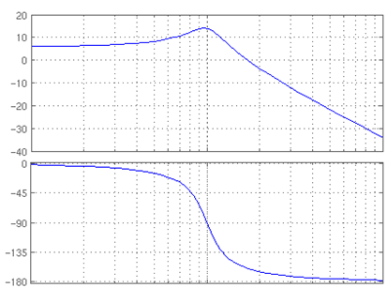
Bode Plot
Draw magnitude and phase of transfer function
Magnitude
dB
(refer to P500 of the textbook)
Phase
Degree
10⁻¹
10⁰
10¹
Angular Frequency
(log scale)
http://en.wikipedia.org/wiki/File:Bode_plot_template.pdf
Notes:
Can never show the zero

Slide 5
Drawing Bode Plot
By Computer
MATLAB
http://web.mit.edu/6.302/www/pz/
MIT 6.302 Feedback Systems
http://www.wolframalpha.com
Example Input: “Bode plot of -(s+200)^2/(10s^2)”
By Hand
Drawing the asymptotic lines by some simple rules
Drawing the correction terms

Slide 6
Asymptotic Lines: Magnitude

Slide 7
Magnitude
Draw each term individually, and then add them together.

Slide 8
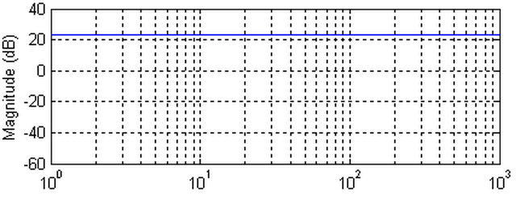
Magnitude – Constant Term

Slide 9
Magnitude – Real Pole
If ω >> |p₁|
Suppose p₁ is a real number
If ω = 10Hz
If ω = 100Hz
Decrease 20dB per decade
If ω << |p₁|
Constant

Slide 10
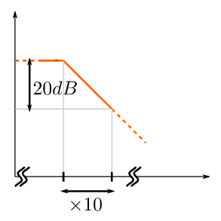
Magnitude – Real Pole
If ω >> |p₁|
Constant
|p₁|
Decrease 20dB per decade
If ω = 10Hz
Magnitude
If ω = 100Hz
Decrease 20dB per decade
If ω << |p₁|
Asymptotic Bode Plot
Constant

Slide 11
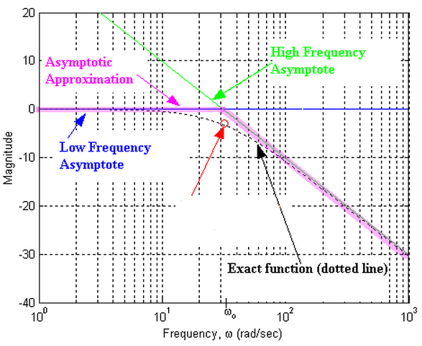
Magnitude – Real Pole
If ω << |p₁|
If ω = |p₁|
Cut-off Frequency
(-3dB)
3dB lower

Slide 12
Magnitude – Real Zero
If ω >> |z₁|
Suppose z₁ is a real number
If ω = 10Hz
If ω = 100Hz
Increase 20dB per decade
If ω << |z₁|
Constant

Slide 13
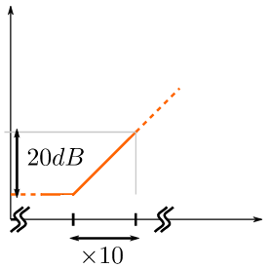
Magnitude – Real Zero
If ω >> |z₁|
Asymptotic Bode Plot
Magnitude
Increase 20dB per decade
If ω = 10Hz
If ω = 100Hz
Increase 20dB per decade
If ω << |z₁|
Constant
|z₁|
Constant

Slide 14
Magnitude – Real Zero
Problem: What if |z₁| is 0?
Asymptotic Bode Plot
Magnitude
|z₁|
If |z₁|=0, we cannot find the point on the Bode plot

Slide 15
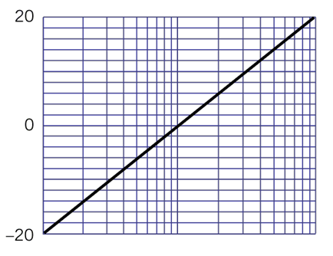
Magnitude – Real Zero
Problem: What if |z₁| is 0?
If |z₁|=0
Magnitude (dB)
If ω = 0.1Hz
Magnitude=-20dB
If ω = 1Hz
Magnitude=0dB
If ω = 10Hz
Magnitude=20dB
Notes:
Line
Increase 20dB/decade
Pass 1Hz, 0dB point

Slide 16
Simple Examples
-20dB
-20dB
+
-20dB
-40dB
+20dB
+
-20dB
-20dB

Slide 17
Simple Examples
-20dB
+20dB
+20dB
+
+20dB
+20dB
-20dB
+

Slide 18
Magnitude – Complex Poles
The transfer function has complex poles
If
constant
If
-40dB per decade

Slide 19
Magnitude – Complex Poles
The asymptotic line for conjugate complex pole pair.
If
constant
If
-40dB per decade
The approximation is not good enough
peak at ω=ω₀

Slide 20
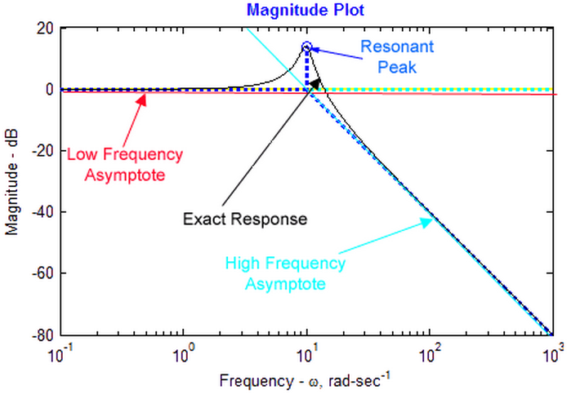
Magnitude – Complex Poles
Height of peak:
constant
Only draw the peak when Q>1
-40dB per decade

Slide 21
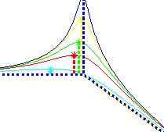
Magnitude – Complex Poles
Draw a peak with height 20logQ at ω₀ is only an approximation
Actually,
The peak is at
The height is

Slide 22
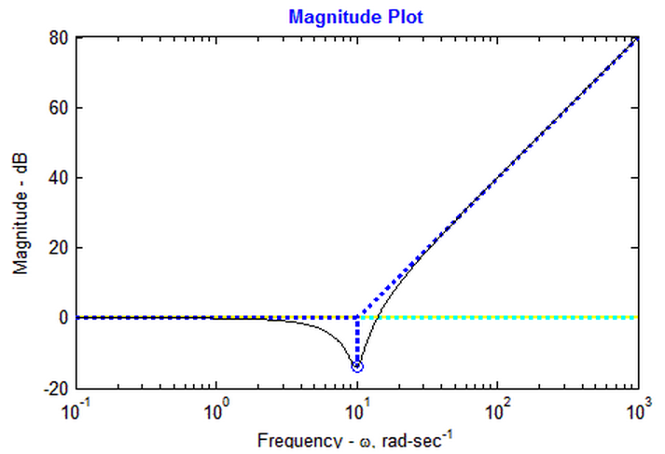
Magnitude – Complex Zeros
+40dB per decade
constant

Slide 23
Asymptotic Lines: Phase

Slide 24
Phase
Again, draw each term individually, and then add them together.

Slide 25
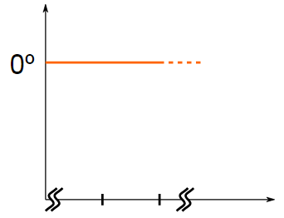
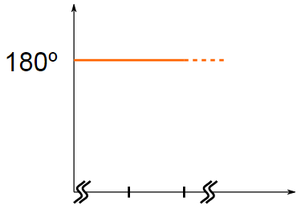
Phase - Constant
Two answers
Notes:
ask

Slide 26
Phase – Real Poles
p₁ is a real number
If ω << |p₁|
If ω = |p₁|
If ω >> |p₁|

Slide 27
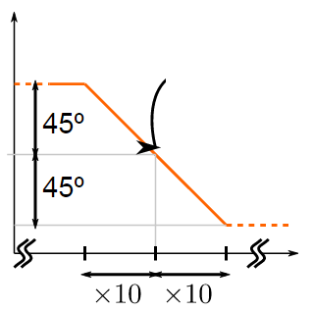
Phase – Real Poles
p₁ is a real number
If ω << |p₁|
0.1|p₁|
|p₁|
If ω = |p₁|
10|p₁|
If ω >> |p₁|

Slide 28
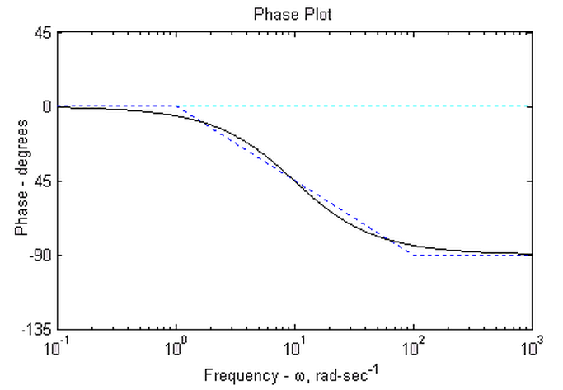
Phase – Real Poles
Exact
Bode Plot
Asymptotic Bode Plot

Slide 29
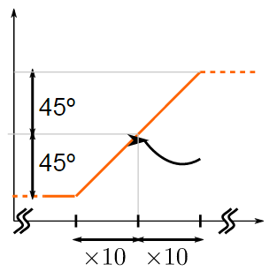
Phase – Real Zeros
If z₁ < 0
z₁ is a real number
If ω << |z₁|
If ω = |z₁|
If ω >> |z₁|
|z₁|

Slide 30
Phase – Pole at the Origin
Problem: What if |z₁| is 0?
Notes:
aks

Slide 31
Phase – Complex Poles
If
If
If

Slide 32
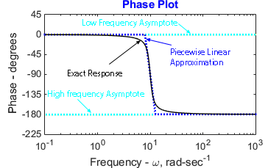
Phase – Complex Poles

Slide 33
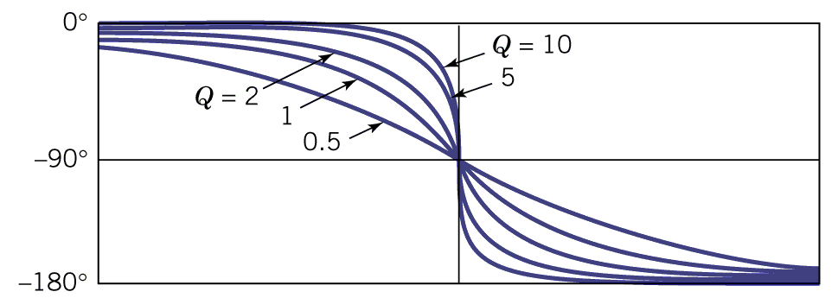
Phase – Complex Poles
The red line is a very bad approximation.
(The phase for complex zeros are trivial.)

Slide 34
Correction Terms

Slide 35
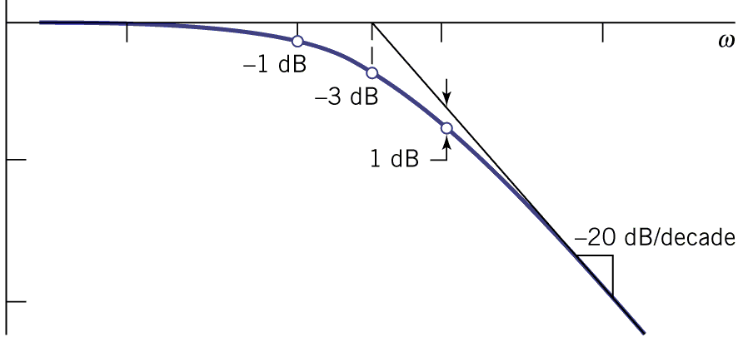
Magnitude – Real poles and zeros
Given a pole p
0.1|P|
0.5|P|
|P|
2|P|
10|P|

Slide 36
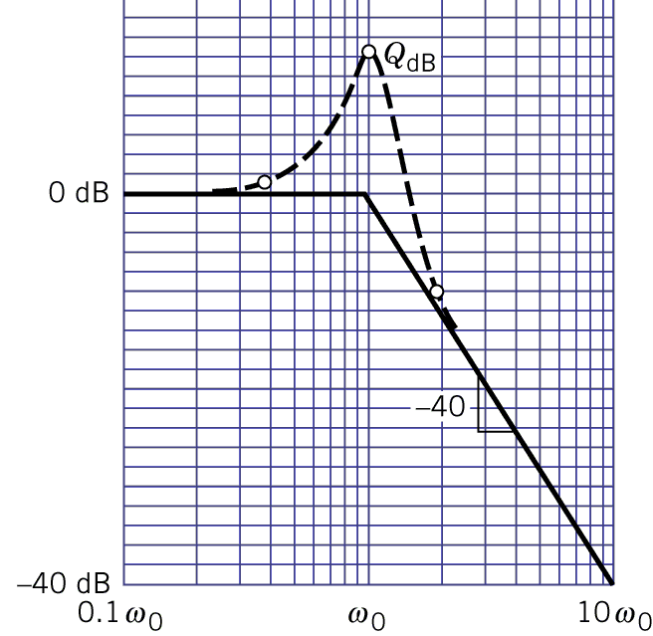
Magnitude – Complex poles and Zeros
Computing the correction terms at 0.5ω₀ and 2ω₀

Slide 37
Phase – Real poles and zeros
Given a pole p
0.1|P|
0.5|P|
|P|
2|P|
10|P|
0。
(We are not going to discuss the correction terms for the phase of complex poles and zeros.)
Notes:
5566 ……

Slide 38
Examples
Notes:
3 examples

Slide 39
Exercise 11.58
Draw the asymptotic Bode plot of the gain for H(s) = 100s(s+50)/(s+100)²(s+400)
If ω << |p|
If ω >> |p|
Decrease 20dB per decade

Slide 40
Exercise 11.58
If ω << |z₁|
If ω >> |z₁|
Increase 20dB per decade

Slide 41
Exercise 11.58
Compute the gain at ω=100
?

Slide 42
Exercise 11.58
Compute the gain at ω=100
Notes:
Why do I know it is 6dB?

Slide 43
Exercise 11.58
-12dB

Slide 44
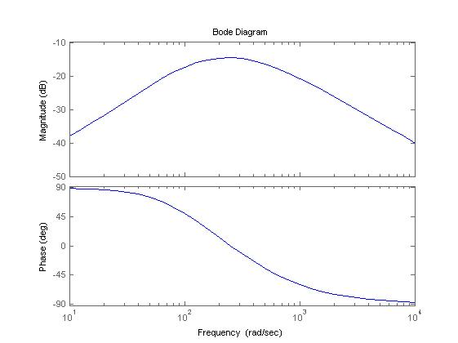
Exercise 11.58
MATLAB

Slide 45
Exercise 11.52
Draw the asymptotic Bode plot of the gain for H(s) = 8000s/(s+10) (s+40)(s+80). Add the dB correction to find the maximum value of a(ω)
8dB
Notes:
Ask someone?

Slide 46
Exercise 11.52
Draw the asymptotic Bode plot of the gain for H(s) = 8000s/(s+10) (s+40)(s+80). Add the dB correction to find the maximum value of a(ω)
8dB
Is 8dB the maximum value?

Slide 47
Exercise 11.52
Draw the asymptotic Bode plot of the gain for H(s) = 8000s/(s+10) (s+40)(s+80). Add the dB correction to find the maximum value of a(ω)
Correction | 5 | 10 | 20 | 40 | 80 | 160
P₁ | -1dB | -3dB | -1dB
p₂ |  |  | -1dB | -3dB | -1dB
p₃ |  |  |  | -1dB | -3dB | -1dB
Total | -1dB | -3dB | -2dB | -4dB | -4dB | -1dB

Slide 48
Exercise 11.52
Draw the asymptotic Bode plot of the gain for H(s) = 8000s/(s+10) (s+40)(s+80). Add the dB correction to find the maximum value of a(ω)
8dB
Maximum gain is about 6dB
Correction | 5 | 10 | 20 | 40 | 80 | 160
P₁ | -1dB | -3dB | -1dB
p₂ |  |  | -1dB | -3dB | -1dB
p₃ |  |  |  | -1dB | -3dB | -1dB
Total | -1dB | -3dB | -2dB | -4dB | -4dB | -1dB

Slide 49
Homework
11.59, 11.60, 11.63

Slide 50
Thank you!

Slide 51
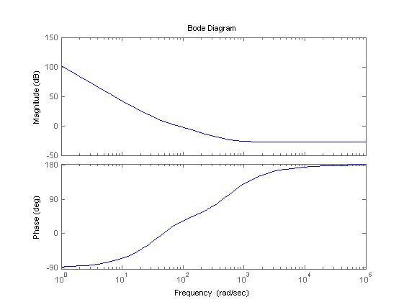
Answer
11.59

Slide 52
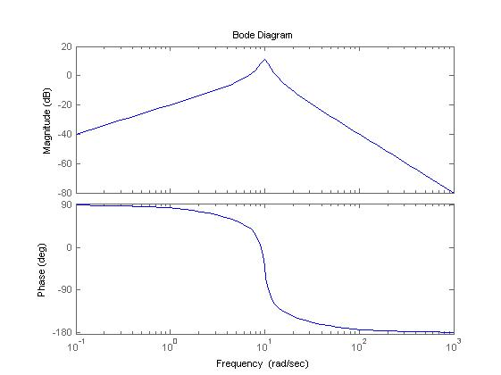
Answer
11.60

Slide 53
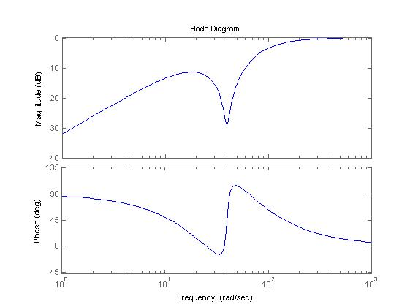
Answer
11.63

Slide 54
http://lpsa.swarthmore.edu/Bode/underdamped/underdampedApprox.html

Slide 55
Examples
http://lpsa.swarthmore.edu/Bode/BodeExamples.html

